Slide 1
App Rating Prediction
Analysis, and observations reported based on different box plots, scatter plots, and histograms

Slide 2
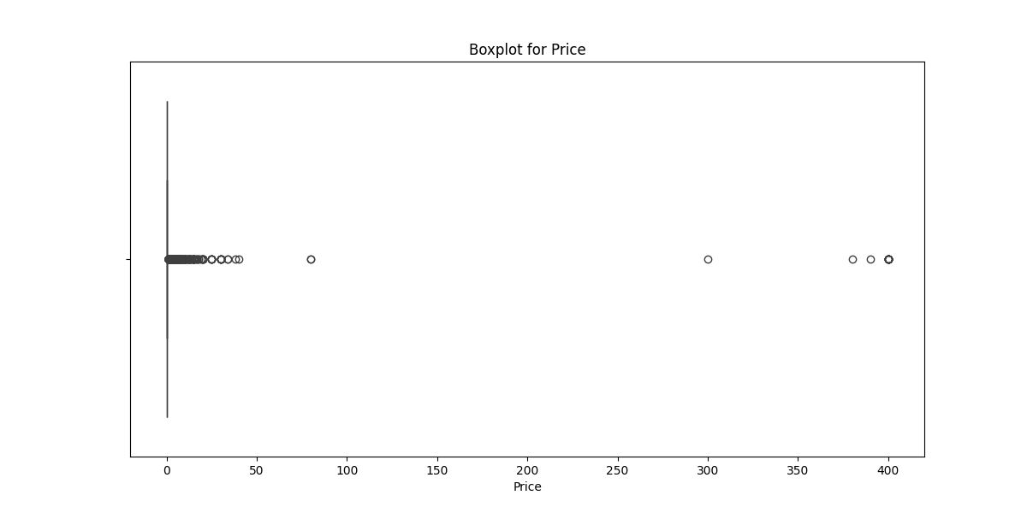
Univariate Analysis – Boxplot for Price (Are there any outliers? Think about the price of usual apps on Play Store.)
The boxplot indicates the presence of outliers in the data. Outliers are represented as individual points outside the whiskers of the boxplot. In this case, there are several outliers on the lower end and a few on the upper end.

Slide 3
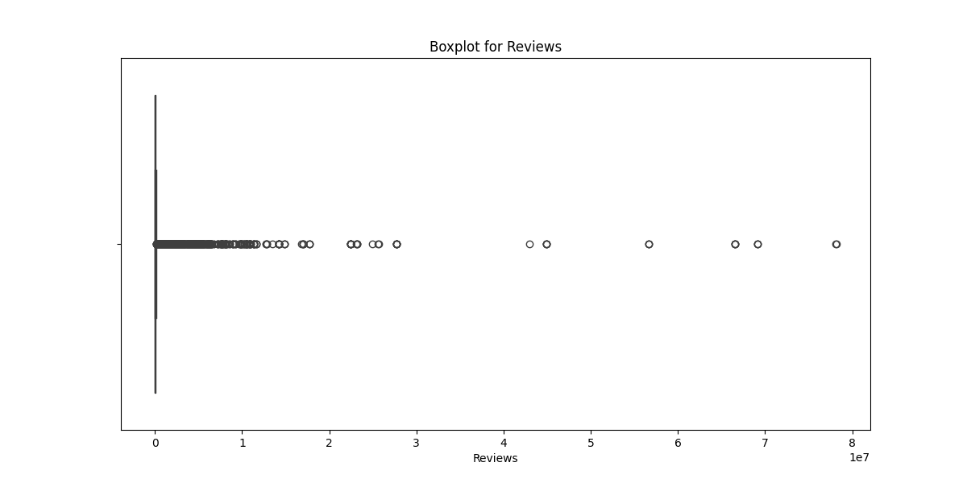
Univariate Analysis – Boxplot for Reviews (Are there any apps with very high number of reviews? Do the values seem right?)
Yes, the boxplot indicates that there are apps with a very high number of reviews, as shown by the outliers on the right side of the plot.
The values for these outliers may seem unusually high compared to most of the data.

Slide 4
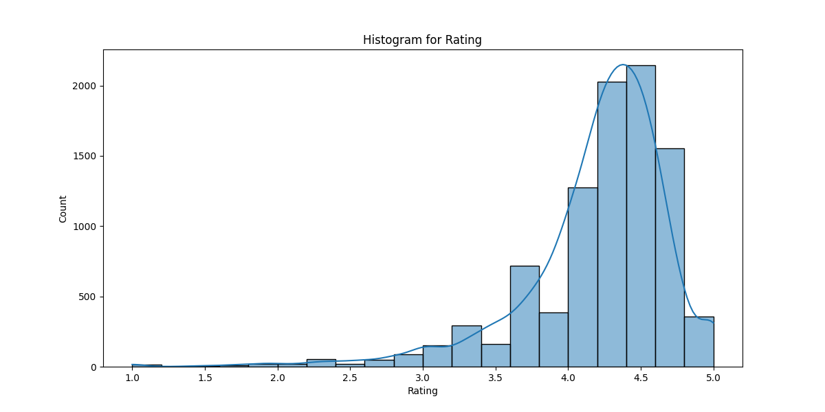
Univariate Analysis – Histogram for Rating (How are the ratings distributed? Is it more toward higher ratings?)
The histogram shows that the ratings are indeed skewed toward the higher end.
Most of the counts are concentrated in the 4.0 to 5.0 range, with a significant peak around 4.5.
There are very few ratings below 3.0, indicating that most ratings are positive.

Slide 5
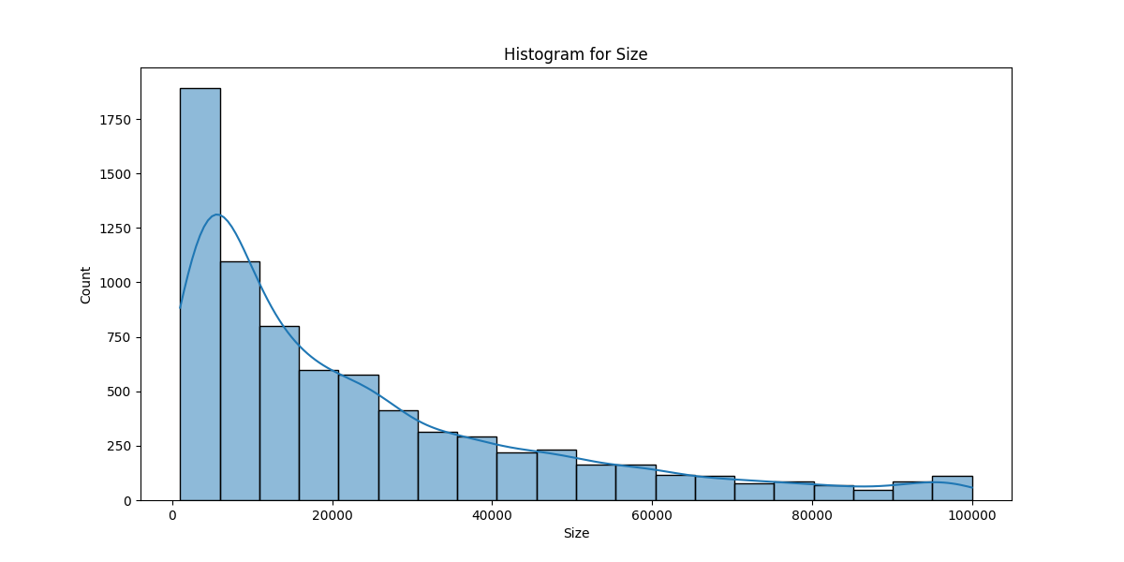
Univariate Analysis – Histogram for Size (How are the size distributed? Is it more toward higher size?)
The histogram shows a right-skewed distribution of sizes.
Most of the data points are concentrated at the lower end (near zero), with a gradual decrease in frequency as the size increases.
This indicates that there are significantly more smaller sizes compared to larger ones. Therefore, the distribution is not more toward higher sizes; rather, it is predominantly toward lower sizes.

Slide 6
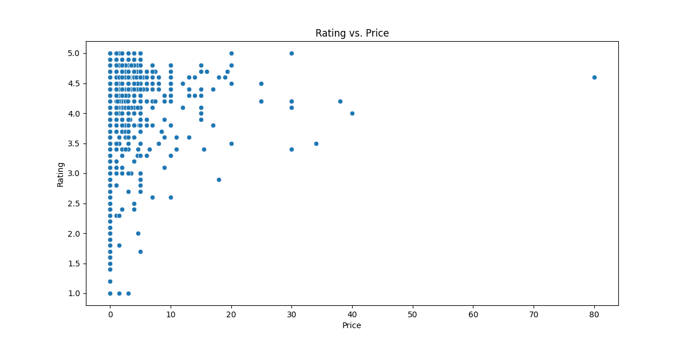
Bivariate analysis – Scatterplot for Rating vs Price (What pattern do you observe? Does rating increase with price?)
The scatter plot shows a general trend where ratings tend to increase with price, but the relationship is not strictly linear.
Concentration of Points: Most ratings are clustered around the higher end (4.0 to 5.0) for lower prices (0 to 20).
Diminishing Returns: As the price increases beyond a certain point, the ratings do not increase significantly, indicating that higher prices do not always correlate with higher ratings.
Outliers: There are a few high-priced items with lower ratings, suggesting that price does not guarantee quality.
Overall, while there is a tendency for ratings to increase with price, the relationship is complex and influenced by other factors.

Slide 7
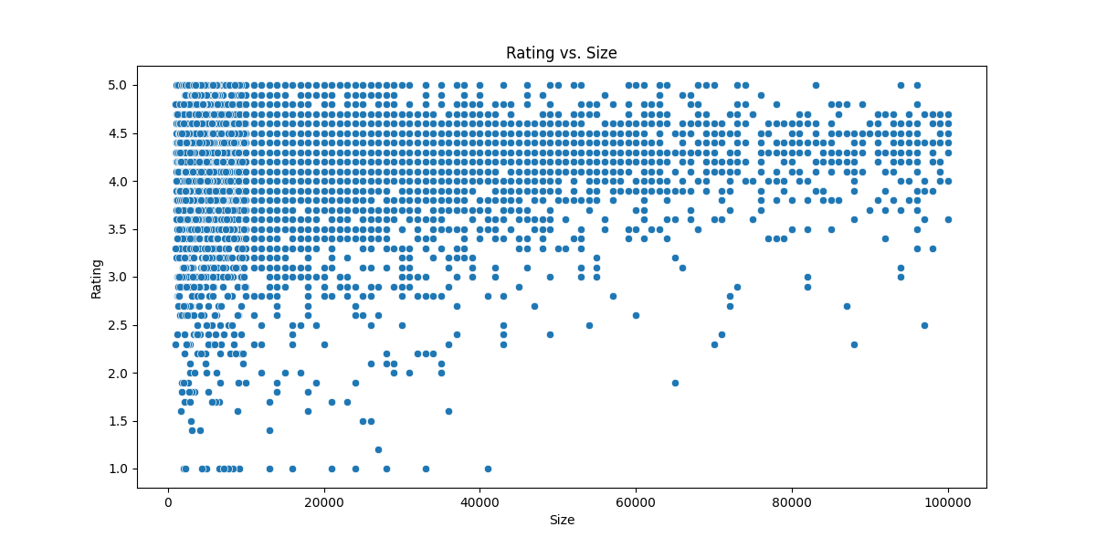
Bivariate analysis – Scatterplot for Rating vs Size (Are heavier apps rated better?)
From the plot, it appears that there is a slight trend where larger apps tend to have higher ratings, particularly in the higher rating range (4.0 to 5.0). However, there are many smaller apps that also receive high ratings, and some larger apps have lower ratings.
While there may be some correlation, it's not strong enough to say that heavier apps are consistently rated better. Other factors likely influence app ratings as well.

Slide 8
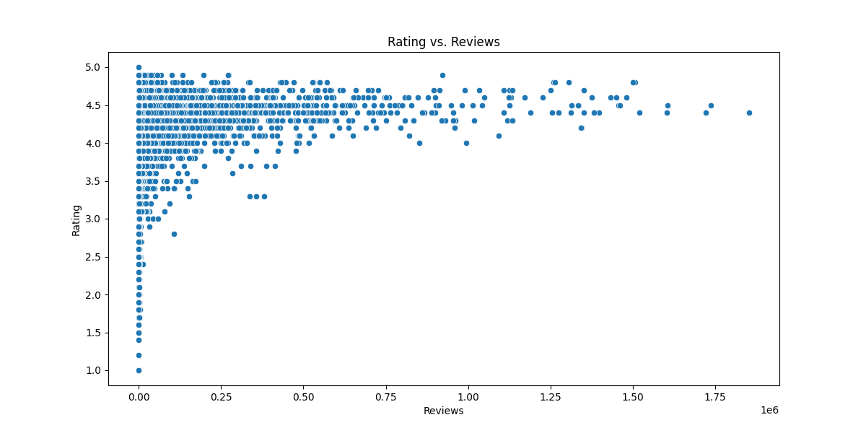
Bivariate analysis – Scatterplot for Rating vs Reviews (Does more review mean a better rating always?)
The scatter plot shows a general trend where higher ratings tend to correlate with a larger number of reviews, but this is not a strict rule.
Several factors can influence this relationship:
Quality of Reviews: A product with many reviews might have a mix of positive and negative feedback, affecting the overall rating.
Rating Distribution: Some products may have a high number of reviews but still receive low ratings if most reviews are negative.
Market Dynamics: Popular products may accumulate more reviews, but that doesn't guarantee they are rated highly.
Bias in Review Systems: Some platforms may have biases that affect how ratings are given, regardless of the number of reviews.
In summary, while there can be a correlation between the number of reviews and ratings, it is not a definitive indicator of quality.

Slide 9
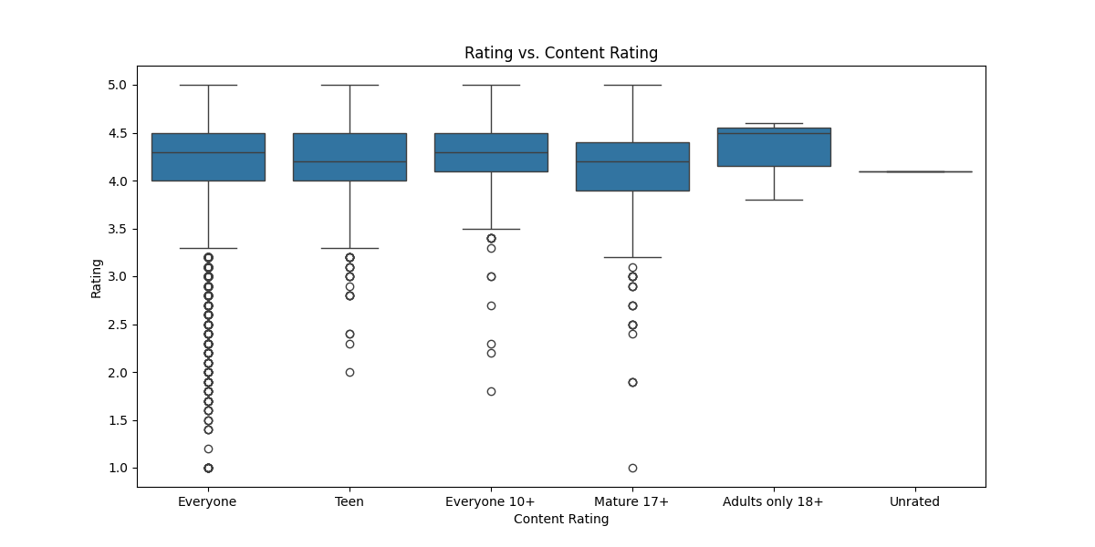
Bivariate analysis – Boxplot for Rating vs Content Rating (Is there any difference in the ratings? Are some types liked better?)
Median Ratings: The median ratings for "Everyone," "Teen," "Everyone 10+," and "Mature 17+" appear to be relatively high, generally above 4.0. In contrast, "Adults only 18+" has a lower median, and "Unrated" seems to have the lowest median rating.
Spread of Ratings: The interquartile ranges (IQRs) for "Everyone," "Teen," and "Everyone 10+" are quite narrow, indicating that most ratings are clustered closely around the median. The "Mature 17+" category has a wider spread, suggesting more variability in ratings.
Outliers: There are several outliers in the "Mature 17+" and "Adults only 18+" categories, indicating that while some users rated these highly, others rated them much lower.
Overall Preference: The higher median ratings for "Everyone," "Teen," and "Everyone 10+" suggest that these content types are generally liked better compared to "Adults only 18+" and "Unrated."
In summary, it seems that content rated for younger audiences tends to receive higher ratings, while adult content may be more polarizing.

Slide 10
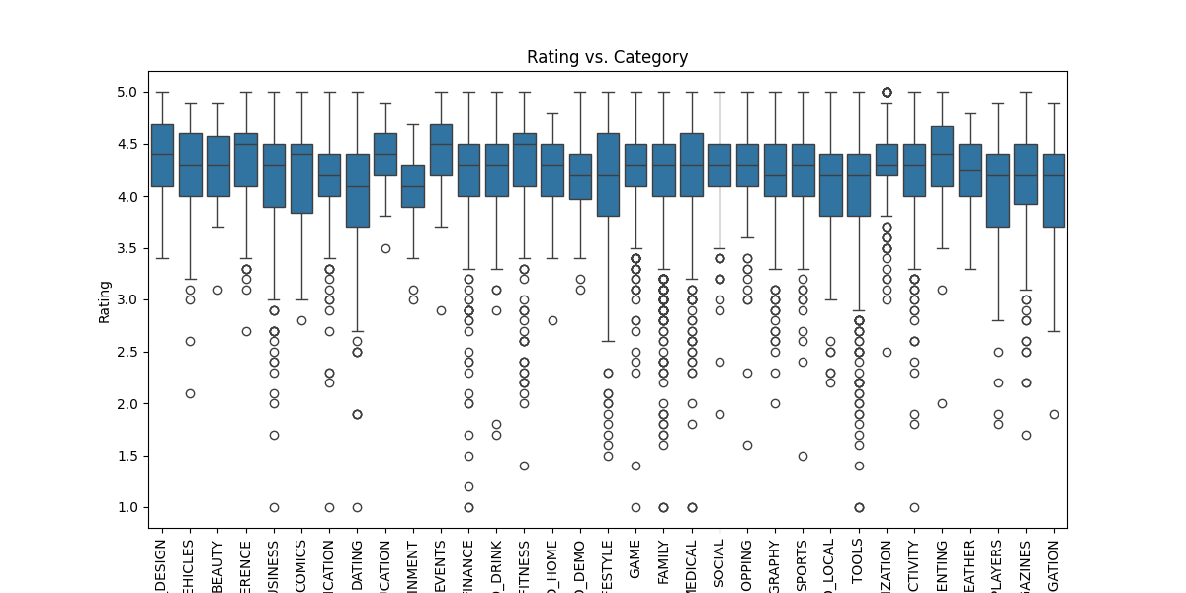
Bivariate analysis – Boxplot for Rating vs Category (Which genre has the best ratings?)
From the box plot, it appears that the genres with the highest median ratings are "DESIGN," "BUSINESS,“ “LIFESTYLE,” and "FINANCE," as they have the tallest boxes and the highest median lines. These genres likely have the best ratings overall.

